Slide 1

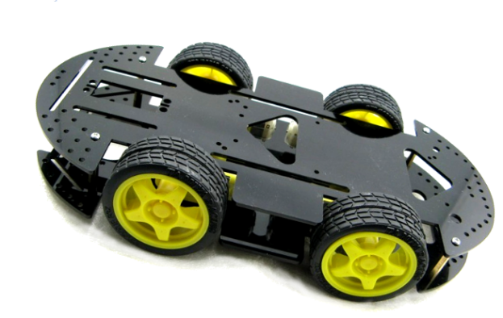
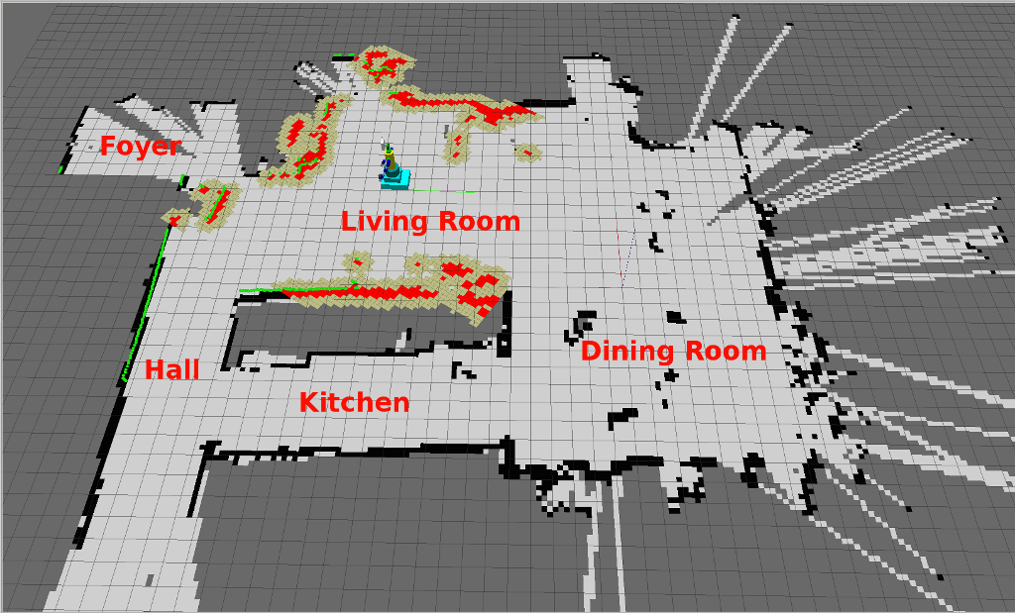
Simultaneous Localization
And Mapping
(SLAM)

Slide 2
What is SLAM?
It is the process of discovering the environment Around
the robot and also the robot discover its location in the
environment simultaneously.
So what is the problem now?

Slide 3
Problem
The problem is localization can’t precedes mapping or
vise versa.
In other words both must be done simultaneously as the
localization relies on the mapping and also the mapping relies on the localization.

Slide 4
How the SLAM process works
1.The robot has to discover the environment.
2. At the same time it has to determine its location with respect to the discovered environment.
3. The robot has to keep moving discovering the environment more and keeps determining his location with respect to the discovered parts of the environment.

Slide 5
Landmarks
1.The robot first has to determine landmarks or some points in the environment it is placed in.
2. The robot then moves and determines its position with respect to the previously discover landmark.
3. By repeating this process the robot can discover the whole environment.

Slide 6
The Bigger Problem
There is a much bigger problem in the SLAM than mapping and localization simultaneously the bigger problem is that there is always and error and the accumulation of this error will cause a huge difference between the estimated position of the robot and the actual position of the robot which produces a completely different map of the environment.

Slide 7
Error problem solution
The problem resulting due to error which we previously discussed is solved using the Kalman Filter or the extended Kalman filter.

Slide 8
EKF
How the Kalman filter works?
1.The Kalman filter takes the current position of the robot and the landmark as input.
2. It also takes the input the robot takes as an input.
3. By these input the Kalman filter can predict the next position of the robot.
4. By determining the new position of the robot and the expected position of the robot it can correct it position with respect to the environment.

Slide 9
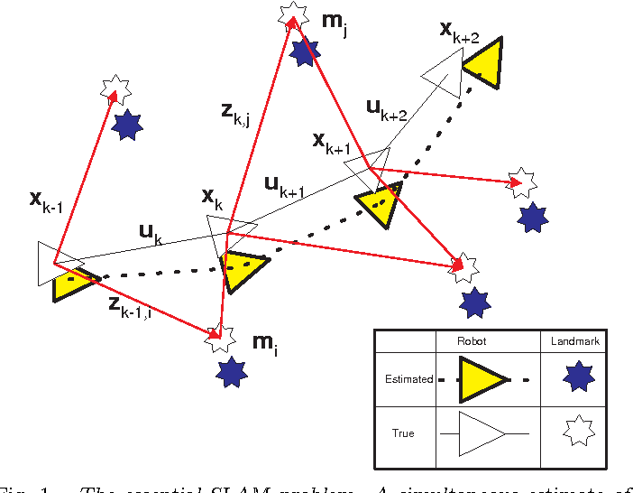
This Figure clearly describes how EKF works.

Slide 10
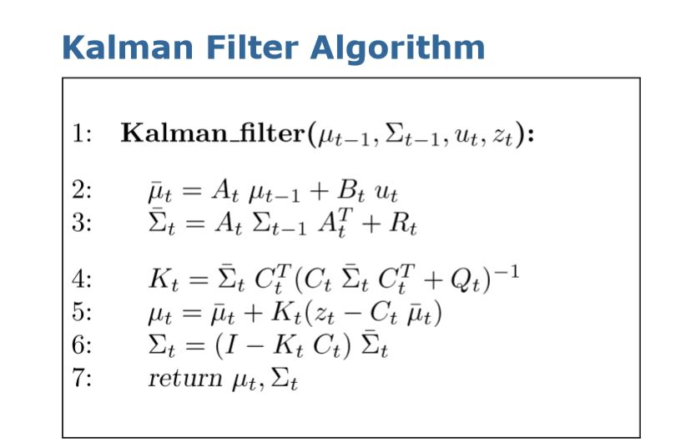

Slide 11
KF Explanation
The first 2 step in the algorithm (No. 2 & 3) are to predict the next position of the robot.
The remaining 3 steps (No 4-6) are to correct the position of the robot according to landmarks after it has moved to its new location.

Slide 12
KF Vs EKF
Kalman filter assumes a Gaussian distribution so we must have linear model but he extended Kalman filter applies an approximation to the non-linear model to linearize in order to apply the Kalman filter.

Slide 13
Hardware
From the previous explanation we can deduce the hardwa needed is:
Robot
Sensor to measure the odometry
Sensor to discover the environment
Microcontroller or small computer to control and calculate.

Slide 14

1.0 Robot
A Wheeled robot is going to be used and it has 4 motors which facilitates the motion and rotation of the robot.

Slide 15
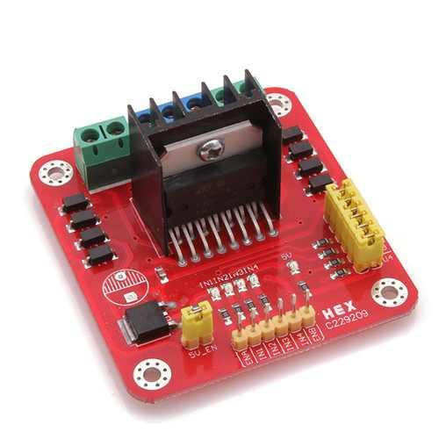
1.1 Motor Driver
L298 Dual H-Bridge Motor Driver is going to be used.
2 channel H-Bridge with 2A peak current.

Slide 16
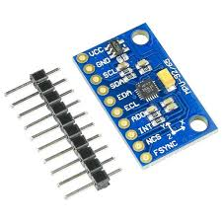
2.0 Odmetry
Inertial Measuring unit MPU-9250 is going to be use.
3 Axis gyro and 3 Axis Accelerometer.

Slide 17
3.0 Range Finder
Camera
Laser-Based Sensor
Ultrasonic

Slide 18
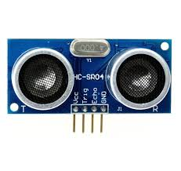
3.1 Ultrasonic
Ultrasonic can be used in the current state of the project till we know if we can have Lidar or no, and if we can’t have the Lidar a camera may be used.

Slide 19
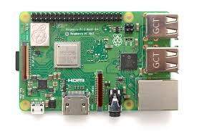
4.0 Small computer
Raspberry pi 3B+ is going to be use to control the robot.

Slide 20
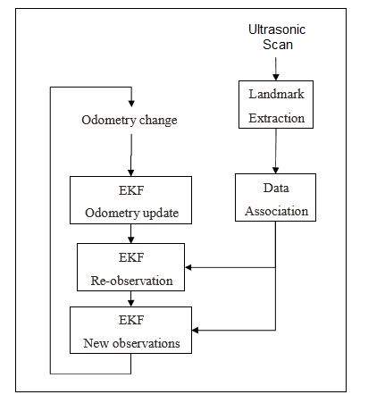
SLAM process diagrammatic presentation.

